Slide 1
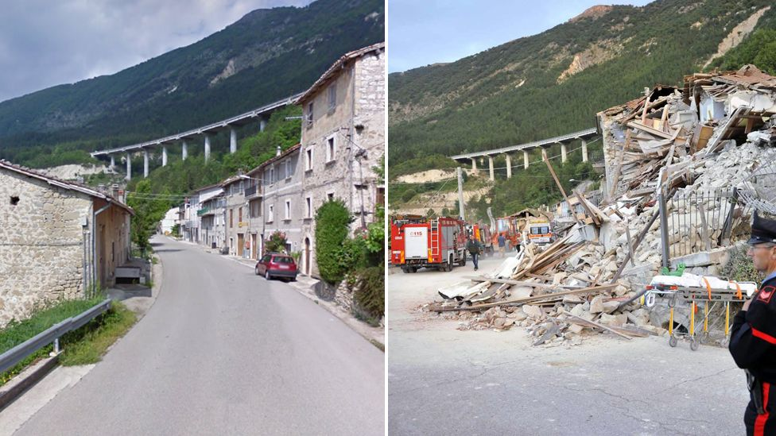
Daily Review
CFU 1
What are Earthquakes? What causes them?
Earthquakes
Earthquakes are sudden movement or shaking of the Earth caused by stress between tectonic plates.
They occur at plate boundaries and result in breakage of the Earth’s brittle crust.
CFU 2
Where do Earthquakes happen ?

Slide 2
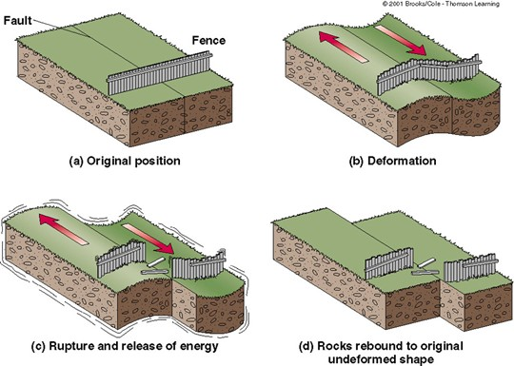
Daily Review
Vocabulary
fault: fracture or group of fractures in a block of rock
CFU 1
Explain the stick - slip motion of tectonic plates.
Plate tectonic stresses
When rock moves at plate boundaries and fault zones, there is friction.
They move in a STICK-SLIP motion; with p periods of no movement (stick) and fast movement (slip)
Energy is stored as plates stick and this energy is released when they slip.
CFU 2
Where does the energy released during an earthquake come from?

Slide 3
Tsunamis Year 9 Earth Science

Slide 4
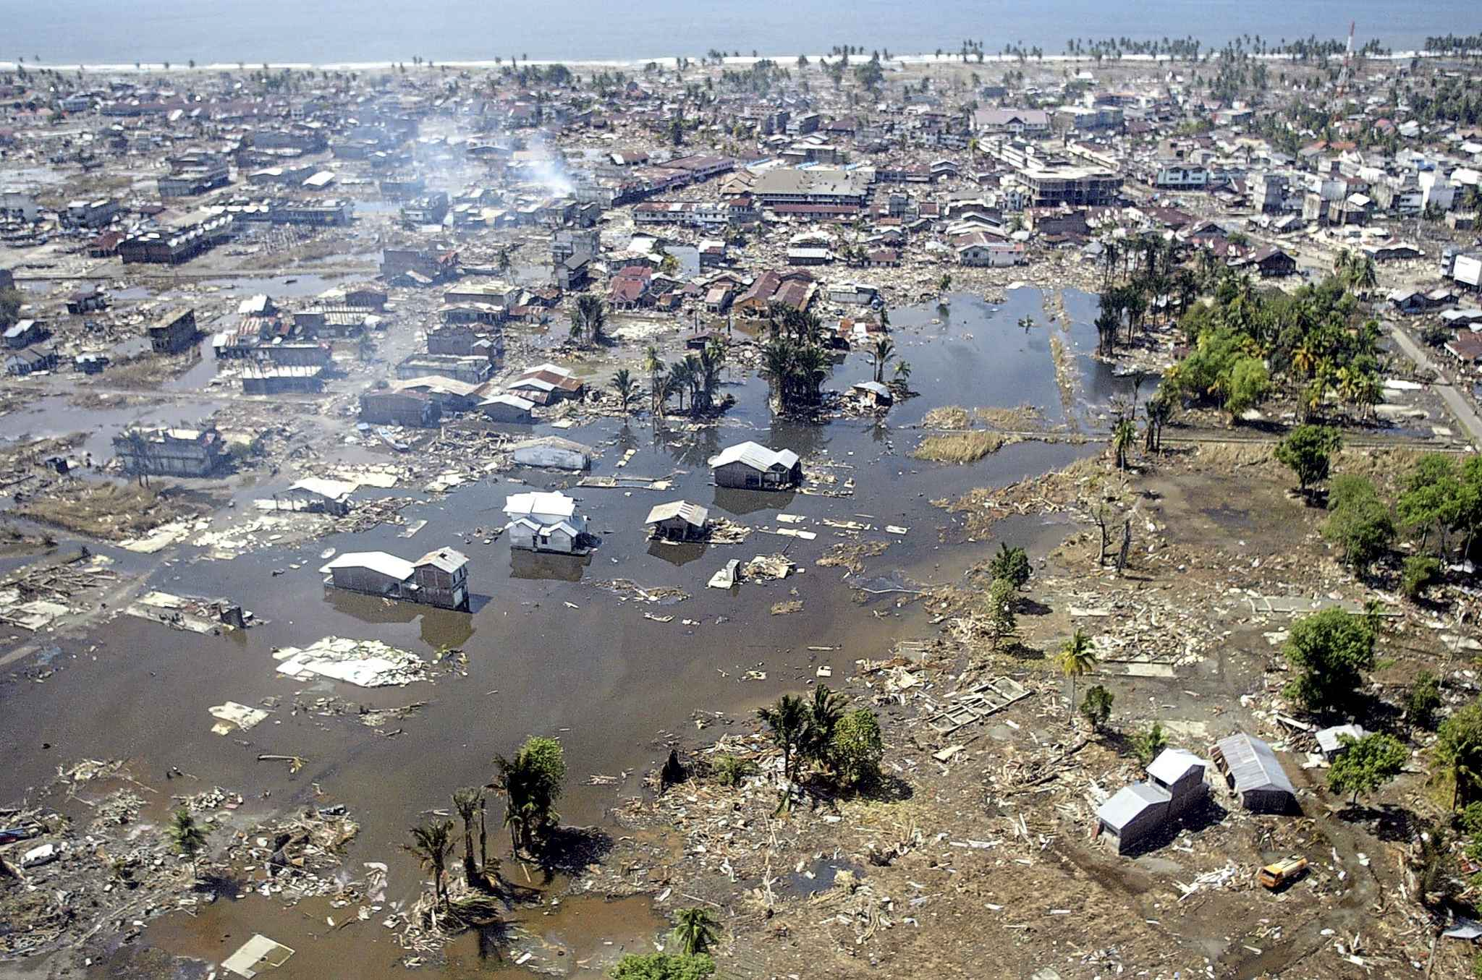
Learning Objective
CFU
What are we going to learn?
Define tsunamis.
Explain how tsunamis are formed
Activate Prior Knowledge
In 2004, a tsunami hit the islands off the coast of the Indonesian island of Sumatra.
Think, Pair, Share: How would this tsunami have affected people’s everyday lives?

Slide 5
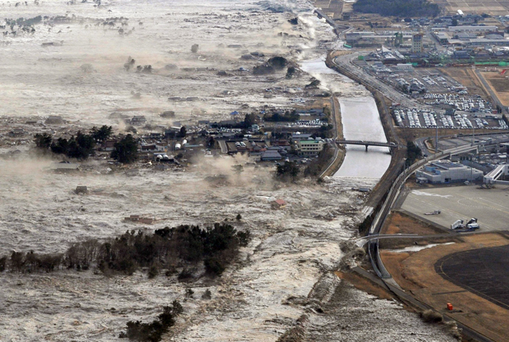
Concept Development
CFU 1
What is a tsunami?
Tsunamis
A tsunami is a series of large waves caused by undersea earthquakes, volcanic eruptions or landslides.
They can reach a height of 30 metres on land
These walls of water can cause massive destruction.
CFU 2
What causes a tsunami?

Slide 6
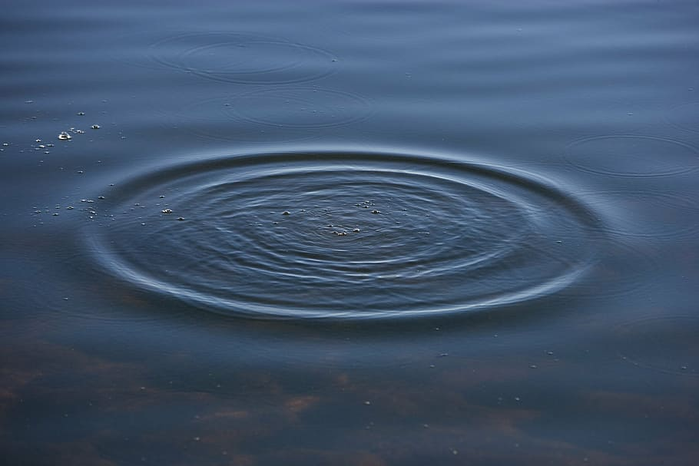
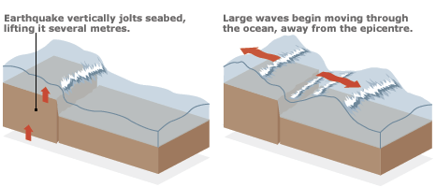
Concept Development
CFU 1
What events can trigger a tsunami?
Forming Tsunami
Disruption to the seafloor by earthquakes, volcanic eruptions or landslides can trigger a tsunami.
The movement of the seafloor displaces the water above it.
This forms large waves which radiate in all directions, similar to dropping a pebble into water.
CFU 2
How are tsunamis formed?
Vocabulary
displace: move something from its usual place or position.

Slide 7
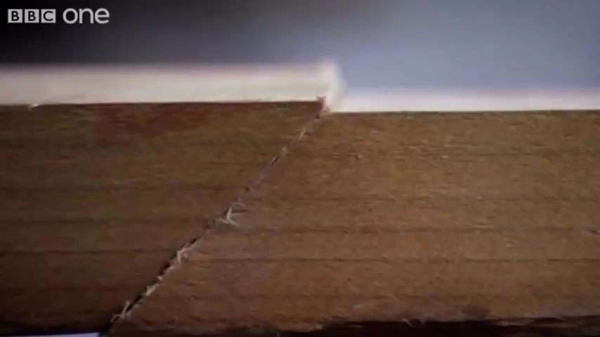
How Earthquakes Trigger Tsunami

Slide 8
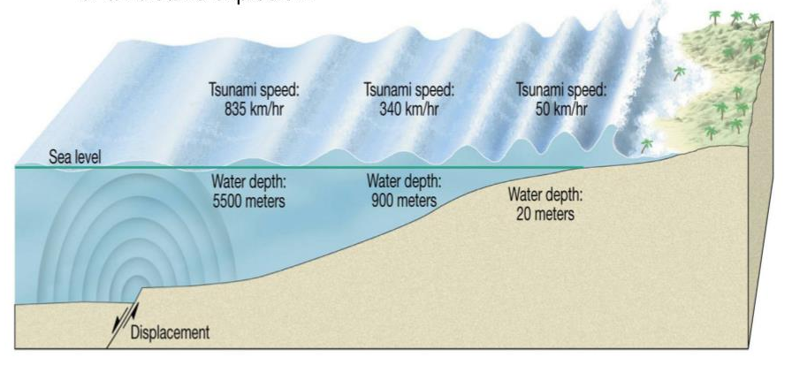
Concept Development
CFU 1
What happens to the height of the wave as a tsunami approaches shallow water?
Forming Tsunami
The waves travel towards land and increase in height as the depth of the ocean decreases.
In the open ocean, the energy from the earthquake is contained in a large volume water forming small waves.
When the wave enters shallow water, the energy is held by a smaller volume of water so the wave height increases
CFU 2
Explain why tsunami waves are small in open water and grow larger towards land.
Vocabulary
displace: move something from its usual place or position.

Slide 9
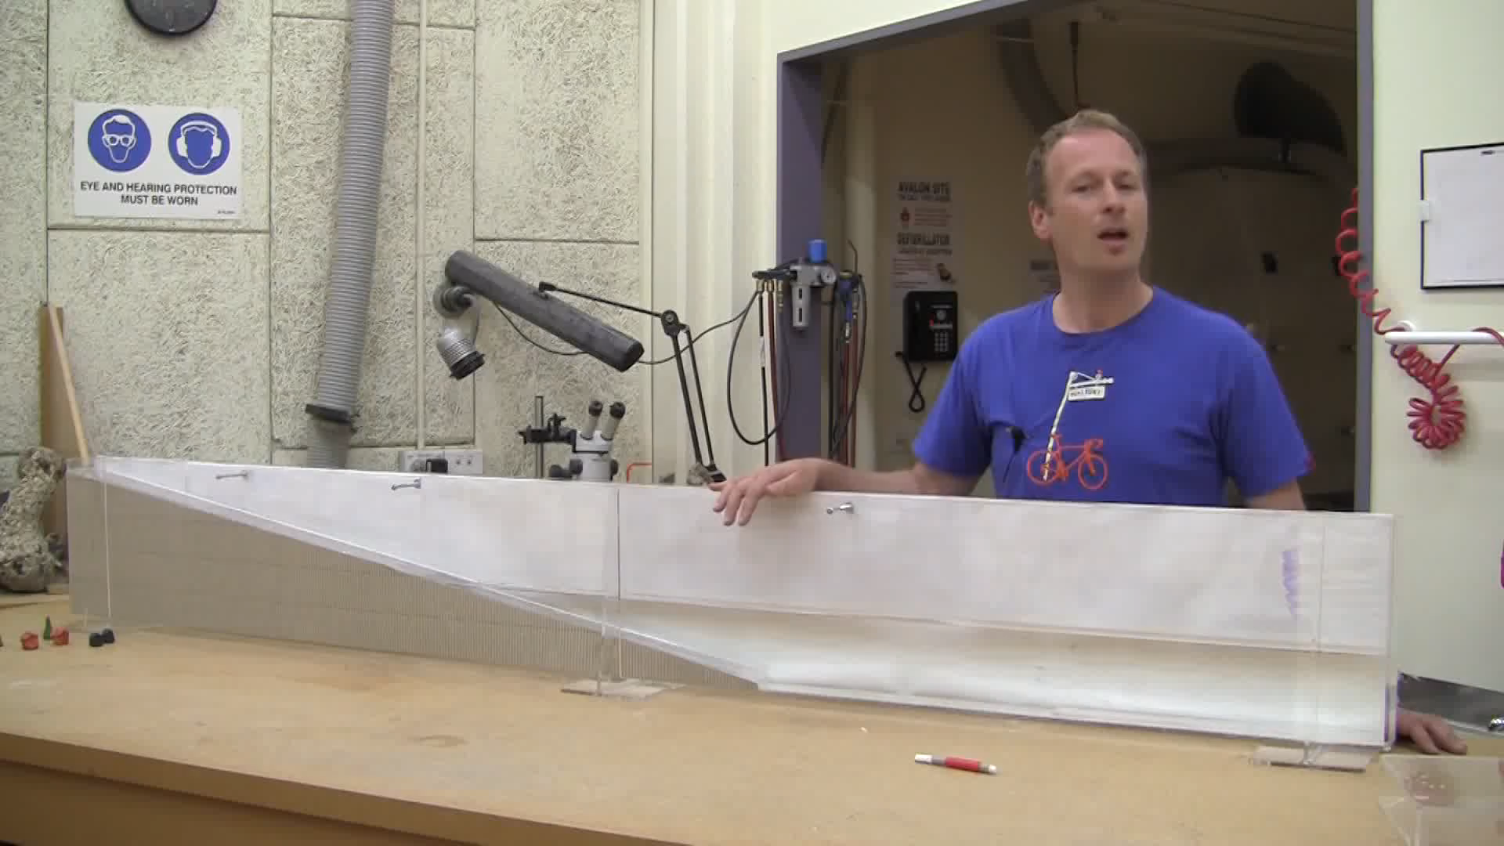
Wave Tank Demonstration

Slide 10
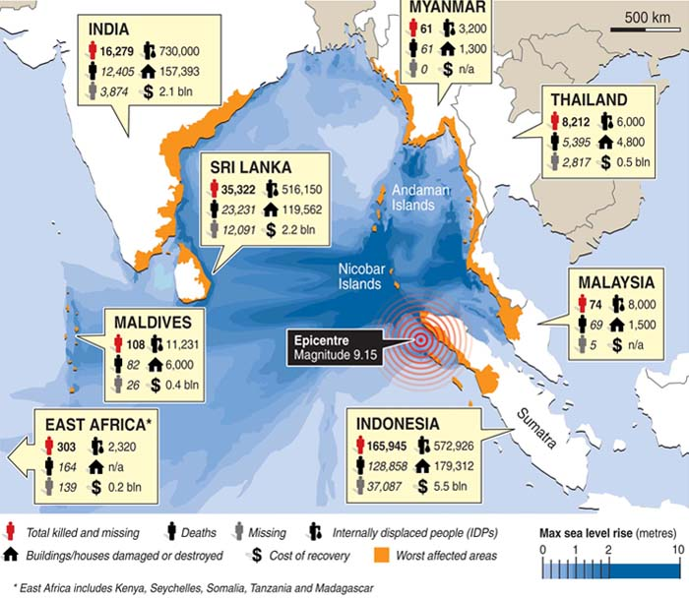
Concept Development
2004 Boxing Day Tsunami Statistics
Damage Caused by Tsunamis
Loss of life and displacement of people from their homes
Damage to buildings, infrastructure property and farms
Environmental impacts
Fresh water sources are contaminated with salt water, making farming impossible for at least a year.
Industrial and commercial chemicals, and raw sewage are washed out and deposited on ground
CFU 1
What long term impacts would a tsunami have on a community?

Slide 11
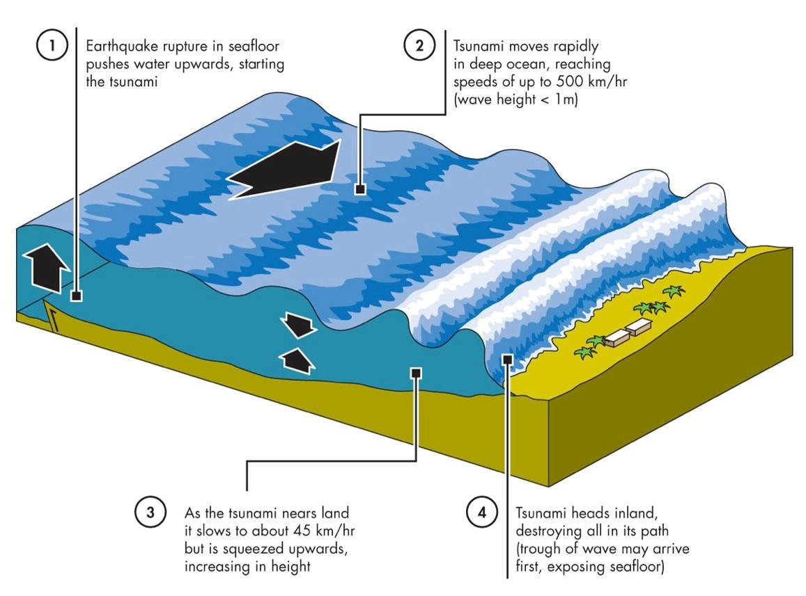
Skill Development/Guided Practice
Explain how tsunamis form using the diagram.
Think, Pair, Share: What is the first stage of tsunami formation?
An underwater earthquake or volcanic eruption displaces the water above the sea floor, starting waves.
Vocabulary
displace: move something from its usual place or position.

Slide 12
Skill Development/Guided Practice
Explain how tsunamis form using the diagram.
Think, Pair, Share: What is the second stage of tsunami formation?
The waves travel through the ocean in all directions.

Slide 13
Skill Development/Guided Practice
Explain how tsunamis form using the diagram.
Think, Pair, Share: What is the third stage of tsunami formation?
The ocean floor rises closer to land, causing the wave to increase in height.

Slide 14
Skill Development/Guided Practice
Explain how tsunamis form using the diagram.
Think, Pair, Share: What is the fourth stage of tsunami formation?
The wave reaches land and floods low-lying areas, causing damage to buildings, farms and water sources.

Slide 15
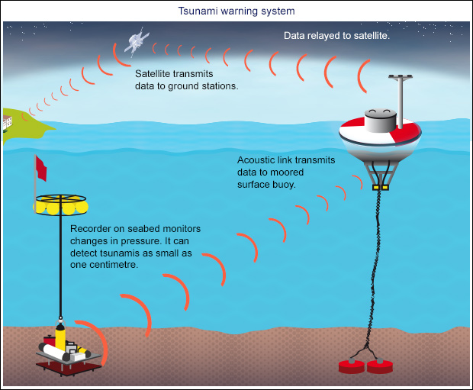
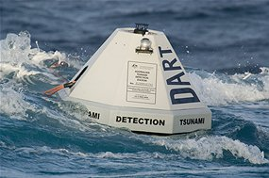
Relevance
Understanding the relationship between tectonic plate movement, earthquakes and tsunamis will help develop early warning systems for tsunamis. Damage and fatalities can be minimised if tsunamis are predicted early and accurately.

Slide 16
Skill Closure
List three events that can trigger a tsunami.
Skill Closure
What are some environmental impacts a tsunami can have on a coastal community.
Skill Closure
Explain why tsunamis increase in height as they move towards land.

Slide 17
Independent Practice
Complete the Tsunami worksheets on your device or a paper copy.

